Slide 1
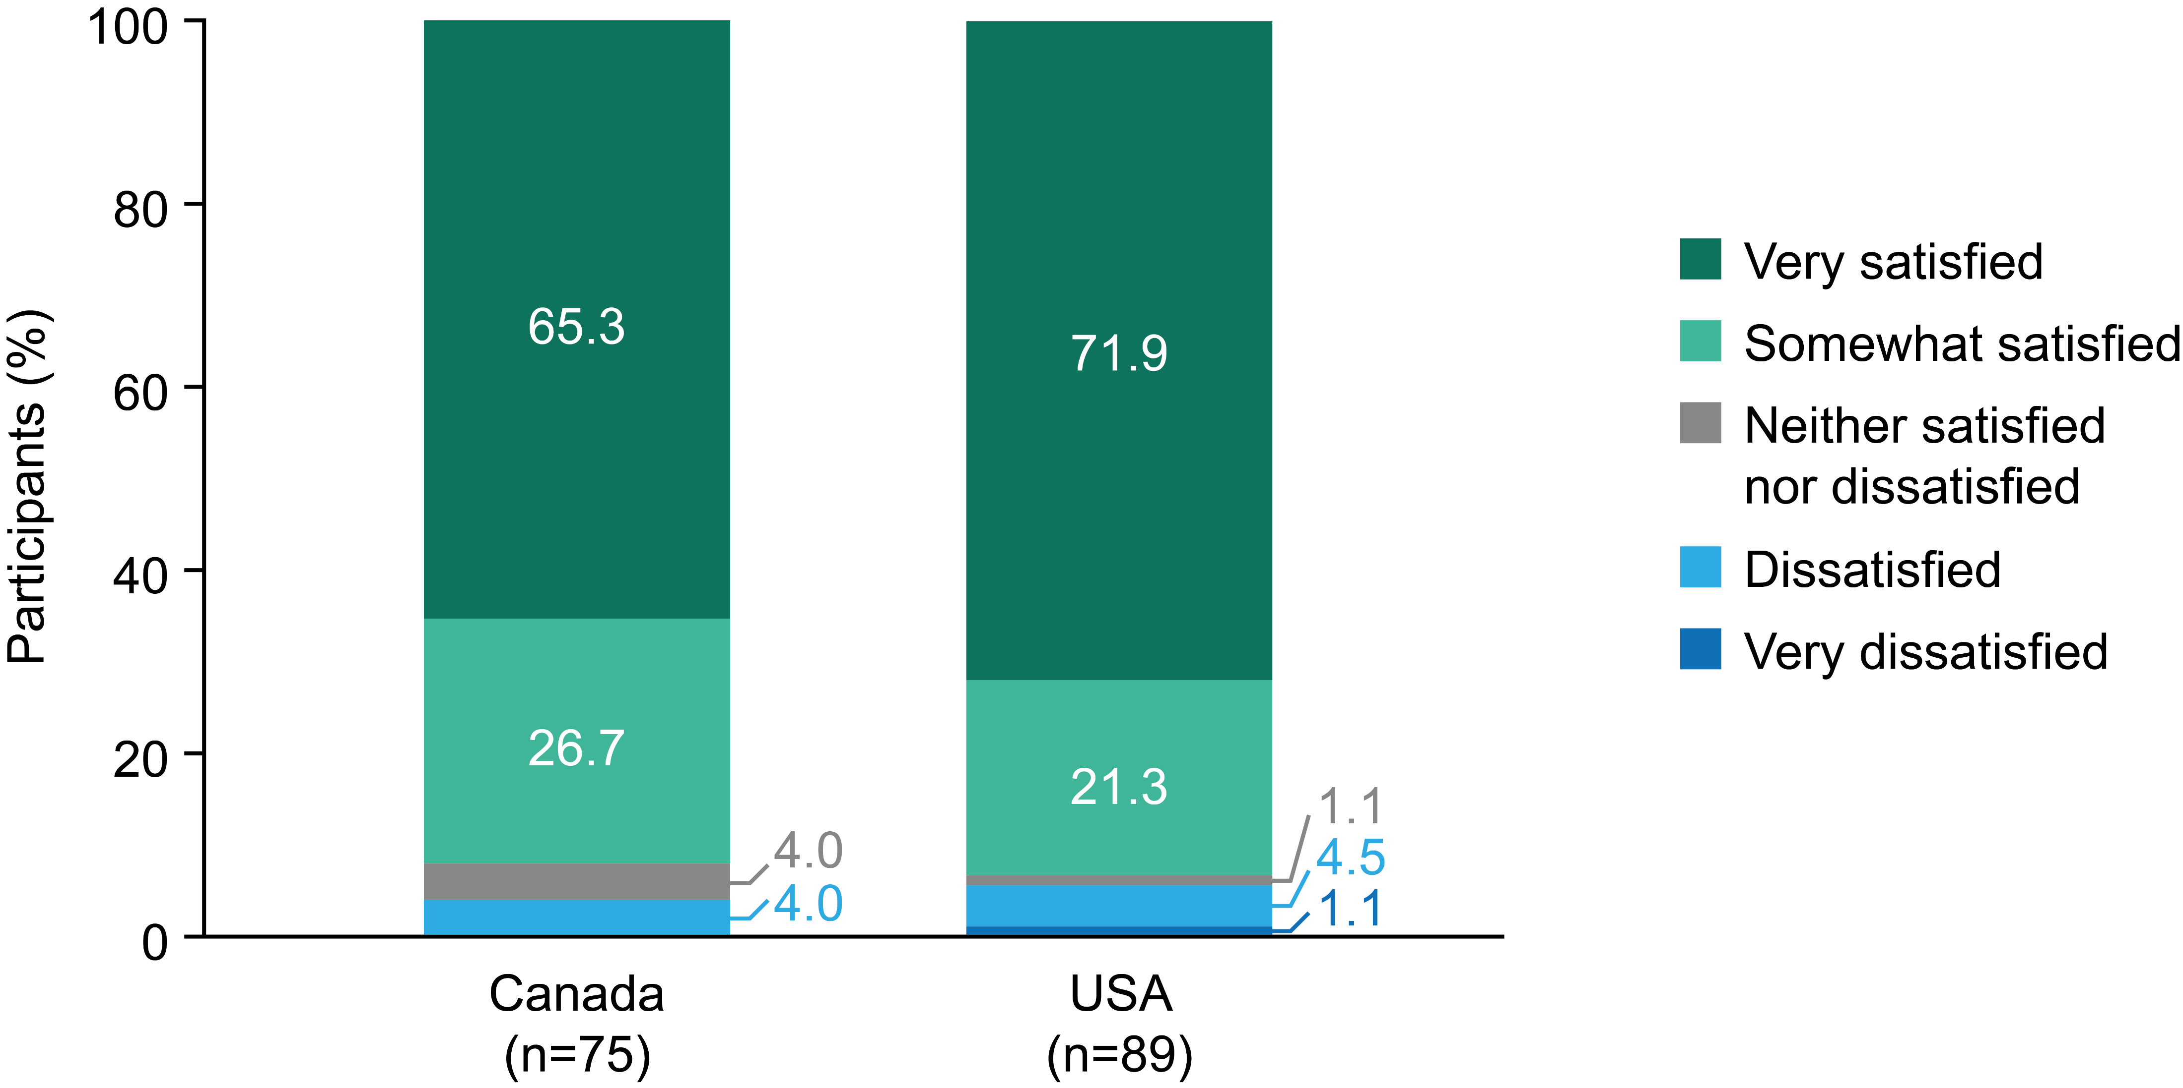
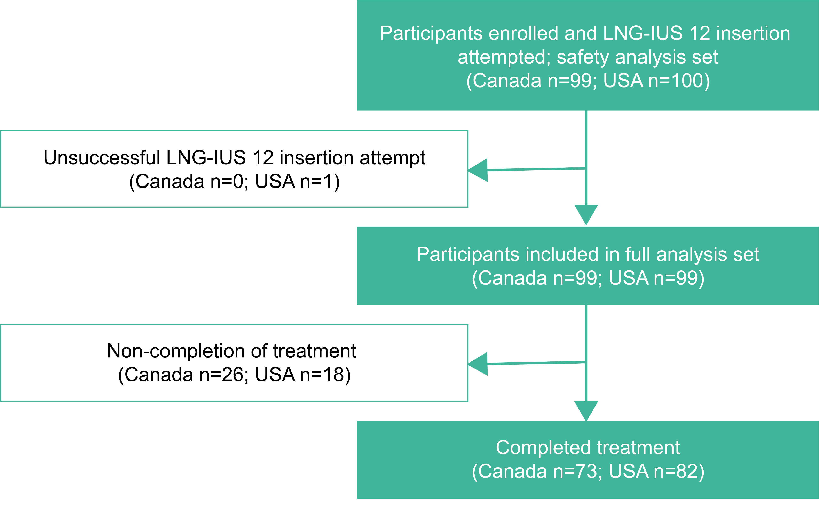
Satisfaction with LNG-IUS 12 in North American women: Findings from the Kyleena® Satisfaction Study
B. Hauck¹, K. Baisden², A-K. FRENZ³ and K. AQUA⁴
Department of Obstetrics and Gynecology, Foothills Hospital, University of Calgary, Calgary, Alberta, Canada; 2. Bayer US LLC, Whippany, New Jersey, USA; 3. Bayer AG, Berlin, Germany; 4. Virtus Research Consultants, Wellington, Florida, USA
Introduction
The levonorgestrel-releasing intrauterine system 12 (LNG-IUS 12) (also known as Kyleena®) is a long-acting method of contraception that has been associated with high satisfaction and continuation rates in clinical trials.^{1–3}
The recent Kyleena® Satisfaction Study (KYSS) provided the first real-world data confirming clinical trial findings and demonstrated in routine clinical practice that continuation rates and user satisfaction were high regardless of age, parity, previous contraceptive method or reason for choosing LNG-IUS 12.⁴
Table 1. Baseline demographics
Figure 2. User satisfaction (percentage, %) with LNG-IUS 12 at 12 months/premature discontinuation
Results
In the subset of North American participants in KYSS, there were 198 (Canada n=99; USA n=99) successful LNG-IUS 12 placements (full analysis set), with placement attempted in 199 women (safety analysis set) (Figure 1).
Full Analysis Set | Canada (n=99) | USA (n=99)
Age, mean±SD | 24.2±7.0 | 26.4±7.3
Age, n (%)
≤17 years | 11 (11.1) | 3 (3.0)
18–25 years | 56 (56.6) | 54 (54.5)
26–35 years | 23 (23.2) | 29 (29.3)
>35 years | 9 (9.1) | 14 (14.1)
BMI, kg/m², mean±SD | 24.4±4.4 | 26.9±6.3
Parity, n (%)
Parous | 12 (12.1) | 28 (28.3)
Nulliparous | 87 (87.9) | 71 (71.7)
Previous contraception during last 3 months, n (%)
Yes | 79 (79.8) | 67 (67.7)
No | 20 (20.2) | 32 (32.3)
Race, n (%)
White | 85 (85.9) | 90 (90.9)
Black | 2 (2.0) | 6 (6.1)
Asian | 6 (6.1) | 2 (2.0)
Not reported | 5 (5.1) | 1 (1.0)
Multiple | 1 (1.0) | 0 (0.0)
Figure 1. Participant flowchart for North American subset
AIM
Our aim here is to report the real-world data on LNG-IUS 12 use from the North American population of KYSS participants.
Note: percentages have been rounded to one decimal place, thus, may not total 100% exactly
Table 2. Discontinuation with LNG-IUS 12 at 12 months/premature discontinuation
Methods
KYSS was a prospective, observational, multicenter, single-arm cohort study conducted with a 12-month follow-up in eight countries, including Canada and the USA, from 2017 to 2018.
Detailed methodology can be found in the previously published primary and interim analyses manuscripts.^{4,5}
Women who independently chose to use LNG-IUS 12 during routine counseling were subsequently recruited into the study. KYSS evaluated overall user satisfaction with LNG-IUS 12. In addition, satisfaction with menstrual bleeding profile, continuation rates, and safety profile in routine clinical practice at 12 months or at premature discontinuation were assessed.
Safety Analysis Set, n (%) | Canada (n=99) | USA (n=100)
LNG-IUS 12 still in use at 12 months | 73 (73.7) | 82 (82.0)
LNG-IUS 12 discontinued before 12 months | 26 (26.3) | 18 (18.0)
Primary reason for end of observation/discontinuation
Lost to follow-up | 16 (16.2) | 7 (7.0)
Unsuccessful LNG-IUS 12 placement | 0 (0.0) | 1 (1.0)
Expulsion of LNG-IUS 12 | 2 (2.0) | 1 (1.0)
Removal of LNG-IUS 12 | 8 (8.1) | 9 (9.0)
Adverse event/adverse drug reaction | 8 (8.1) | 7 (7.0)
Pregnancy | 0 (0.0) | 1 (1.0)
Wish for pregnancy | 0 (0.0) | 1 (1.0)
BMI, body mass index; SD, standard deviation
Reason for choosing LNG-IUS 12
Participants gave a variety of reasons for selecting to initiate LNG-IUS 12 use. The most common were the lack of need for a contraceptive routine (Canada 31/99 [31.3%]; USA 49/99 [49.5%]), high contraceptive reliability (Canada 34/99 [34.3%]; USA 23/99 [23.2%]) and low hormone dose (Canada 21/99 [21.2%]; USA 11/99 [11.1%]). The expectation of shorter, lighter and less frequent bleeding episodes (Canada 14/99 [14.1%]; USA 12/99 [12.1%]), as well as being estrogen-free (Canada 14/99 [14.1%]; USA 4/99 [4.0%]), were also important reasons for selecting LNG-IUS 12.
LNG-IUS 12 user satisfaction
For the 164 North American participants (Canada n=75; USA n=89) with satisfaction data available, most were satisfied (Canada 69/75 [92.0%]; USA 83/89 [93.3%]) with LNG-IUS 12 at 12 months/premature discontinuation with the majority very satisfied (Canada 49/75 [65.3%]; USA 64/89 [71.9%]) (Figure 2).
Satisfaction rates were similar for parous (Canada 6/8 [75.0%]; USA 22/24 [91.7%]) and nulliparous (Canada 63/67 [94.0%]; USA 61/65 [93.8%]) women.
The majority were satisfied with their menstrual bleeding profile at 12 months/premature discontinuation (Canada 49/74 [66.2%]; USA 64/80 [80.0%]).
LNG-IUS 12 continuation and safety profile
The 12-month continuation rate was 73.7% (73/99) for Canadian women and 82.0% (82/100) for US women (Table 2). Most discontinuations were a result of loss to follow-up (Canada 16/99 [16.2%]; USA 7/100 [7.0%]) or treatment-emergent adverse events (TEAEs) (Canada 10/99 [10.1%]; USA 8/100 [8.0%]). There were few discontinuations due to bleeding-related TEAEs (Canada 4/99 [4.0%]; USA 5/100 [5.0%]) (Table 3).
Overall, 16/99 (16.2%) Canadian women and 24/100 (24.0%) US women experienced a TEAE (Table 3). TEAEs were judged to be LNG-IUS 12-related in 13/99 (13.1%) Canadian women and 14/100 (14.0%) US women.
The most common TEAEs in Canadian women were bacterial vaginosis (3/99 [3.0%]), metrorrhagia (3/99 [3.0%]) and vaginal hemorrhage (3/99 [3.0%]). In US women, the most common TEAEs were ovarian cyst (5/100 [5.0%]), abdominal pain (3/100 [3.0%]), dysmenorrhea (3/100 [3.0%]) and pelvic pain (3/100 [3.0%]).
LNG-IUS, levonorgestrel-releasing intrauterine system
Baseline demographics
The Canadian study population (full analysis set) had a mean age (±standard deviation) of 24.2±7.0 years (>90% were younger than 35 years); 12/99 women (12.1%) were parous, and 87/99 women (87.9%) were nulliparous (Table 1).
The US study population (full analysis set) had a mean age (±standard deviation) of 26.4±7.3 years (>85% were younger than 35 years); 28/99 women (28.3%) were parous, and 71/99 women (71.7%) were nulliparous (Table 1).
LNG-IUS 12 placement
Clinicians rated placement ‘easy’ in 88/99 (88.9%) Canadian women and 90/100 (90.0%) US women. Pain during placement was rated as ‘none’ or ‘mild’ by 67/99 (67.7%) Canadian women and 72/100 (72.0%) US women.
Systemic medication during placement was used in 32/99 (32.3%) Canadian women and 21/100 (21.0%) US women, local anesthesia in 16/99 (16.2%) Canadian women and 6/100 (6.0%) US women and cervical dilation in 3/99 (3.0%) Canadian women and 7/100 (7.0%) US women.
Prior contraceptive method
Most participants (Canada 79/99 [79.8%]; USA 67/99 [67.7%]) had been using a form of contraception in the 3 months prior to initiating use of LNG-IUS 12. Oral hormonal contraceptives were the most common method (Canada 36/99 [36.4%]; USA 32/99 [32.3%]), followed by barrier methods (Canada 25/99 [25.3%]; USA 12/99 [12.1%]) and hormonal IUS (Canada 13/99 [13.1%]; USA 8/99 [8.1%]).
LNG-IUS, levonorgestrel-releasing intrauterine system
References
Nelson A, et al. Obstet Gynecol 2013;122:1205‒13.
Gemzell-Danielsson K, et al. Fertil Steril 2012;97:616‒22.
Gemzell-Danielsson K, et al. PLoS One 2015;10:e0135309.
Stovall D, et al. Eur J Contracept Reprod Health Care 2021;26:462‒472.
Beckert V, et al. Eur J Contracept Reprod Health Care 2020;25:182‒9.
Table 3. Summary of TEAEs with LNG-IUS 12 at 12 months/premature discontinuation
Safety Analysis Set, n (%) | Canada (n=99) | USA (n=100)
TEAEs | 16 (16.2) | 24 (24.0)
LNG-IUS 12 related TEAEs | 13 (13.1) | 14 (14.0)
Serious TEAEs | 2 (2.0) | 1 (1.0)
LNG-IUS 12 related serious TEAEs | 1 (1.0) | 1 (1.0)
Discontinuation due to TEAEs | 10 (10.1) | 8 (8.0)
Discontinuation due to bleeding-related TEAEs | 4 (4.0) | 5 (5.0)
Acknowledgements
The authors would like to acknowledge Highfield, Oxford, UK for providing medical writing assistance with funding from Bayer AG.
LNG-IUS, levonorgestrel-releasing intrauterine system; TEAE, treatment-emergent adverse event
CONTACT INFORMATION
Corresponding author: Brian Hauck. Department of Obstetrics and Gynecology, Foothills Hospital, University of Calgary, Calgary, Alberta, Canada. Email: bhauck@telusplanet.net
Conclusions
Both USA and Canada had a high proportion of nulliparous and young participants
Satisfaction rates were similarly high in both USA and Canada regardless of parity
Discontinuation and rates of adverse events were low
These findings demonstrate LNG-IUS 12 is well-tolerated with a high satisfaction and continuation rate in a broad population of North American KYSS participants

