Slide 1
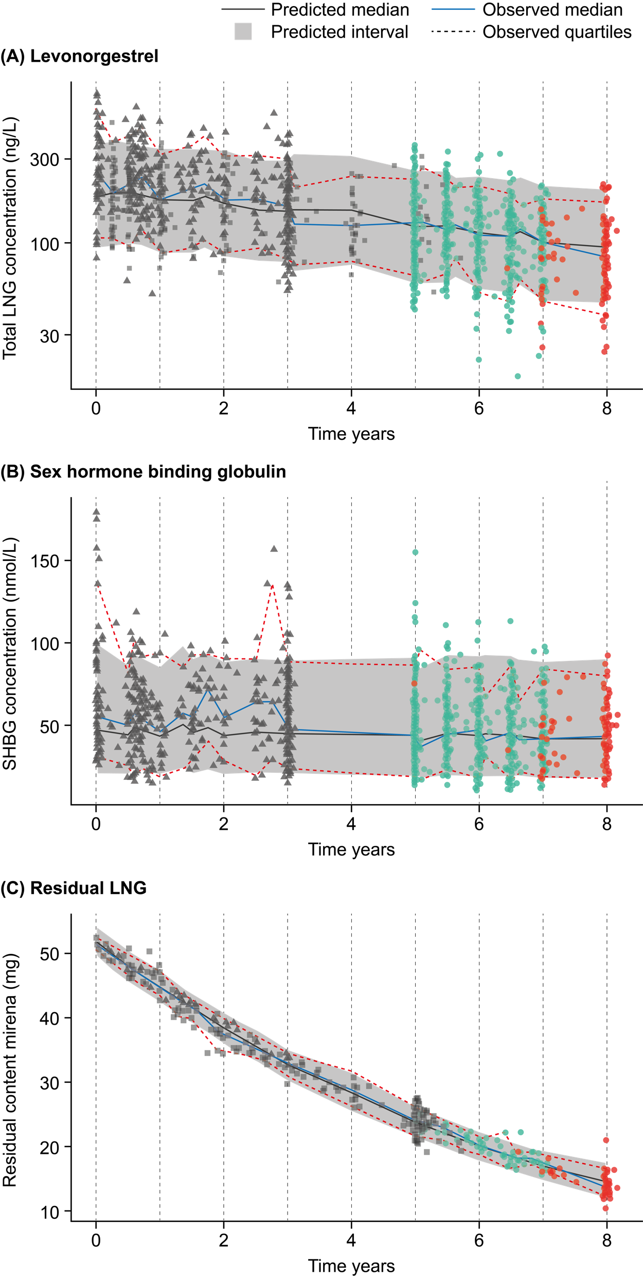
Estimating In Vivo Levonorgestrel Release Rate and Exposure over 8 Years LNG-IUS 52 mg Use with a Population Pharmacokinetic Approach
J. JENSEN¹, I. REINECKE², E. LUKKARI-LAX³ and B. HOFMANN⁴
¹Department of Obstetrics & Gynecology, Oregon Health & Science University, Portland, OR, USA; ²Bayer AB, Solna, Sweden; ³Bayer OY, Espoo, Finland; ⁴Bayer AG, Berlin, Germany
AIM
To characterize the PK profile of LNG-IUS 52 mg (Mirena®) [1] up to 8 years, and to facilitate comparisons with LNG-IUS 19.5 mg (Kyleena®) and LNG-IUS 13.5 mg (Skyla®/Jaydess®) over their respective approved period of use, using a population pharmacokinetic (popPK) approach with data from the Mirena Extension Trial (MET) and earlier clinical trials.
Results
Figure 1. Visual predictive check (VPC) of the model-based predicted concentrations compared to observed concentrations of (A) LNG and (B) SHBG over 8 years of LNG-IUS 52mg use
Estimated SHBG serum concentrations for all 3 LNG-IUS remained relatively stable. Concentrations for LNG-IUS 52mg were slightly lower than for
LNG-IUS 19.5 mg and LNG-IUS 13.5 mg.
The previously estimated fraction of unbound LNG was about 1.6% of the total LNG concentration, confirmed by the popPK analysis.
Model-based estimated in vivo release rates and comparison to LNG-IUS
19.5 mg and LNG-IUS 13.5 mg
8-year release model qualified by standard modeling diagnostic tools, revealed that the model adequately described the data (Figure 1C).
Estimated average in vivo release rate for LNG-IUS 52 mg was 20 µg/day over the first year, 15 µg/day over the first 5 years, and 13 µg/day over the
8 years of LNG-IUS 52 mg use (Figure 3).
At end of Year 8 LNG-IUS 52 mg use, the LNG release rate (7.04 µg/day) was similar to LNG-IUS 19.5 mg after 5 years (~7.6 µg/day) and about 28% higher than for LNG-IUS 13.5 mg after 3 years (~5.5 µg/day) (Figure 3).
Conclusions
The 8-year popPK and release models deliver reliable and complete LNG release rates and LNG exposure estimates for up to 8 years of LNG-IUS 52 mg use, based on a broad data set
In vivo LNG release rates during extended use of LNG-IUS 52 mg from 6 to 8 years are at least on the same level as for lower dose LNG-IUS devices at the end of their approved period of use.
Systemic LNG exposure of LNG-IUS 52 mg during 6 to 8 years is comparable with other LNG-IUS devices and clearly lower than after oral LNG-containing contraceptives.
The similarity of LNG exposure and release rates from LNG-IUS 52 mg at the end of the
8-year-period of use to those of LNG-IUS 19.5 mg at 5 years and LNG-IUS 13.5 mg at 3 years supports clinicians when counseling patients.
Our PK results align with recent clinical findings of efficacy and safety of LNG-IUS 52mg for 6 to 8 years of use (see Jensen, et al. Oral Presentation A13 ACOG 2022).
Participants
501 healthy premenopausal women enrolled in the MET, 362 started year 6, and 232 completed year 8. Baseline characteristics are given in Table 1.
Mean (SD) exposure duration of extended LNG-IUS 52 mg use was 834.1 (368.0) days and total exposure was 827.2 women-years.
Table 1. Baseline characteristics
Characteristic | Full Analysis Set (N=362)
Age at baseline, years Mean (SD) Age group, n (%) 18–25 26–35 >35 | 29.4 (3.1) 41 (11.3) 321 (88.7) 0 (0)
Parity, n (%) Parous Nulliparous | 191 (52.8) 171 (47.2)
Race, n (%) White Black or African American Asian American Indian or Alaska native Not reported Multiple | 273 (75.4) 51 (14.1) 9 (2.5) 2 (0.6) 13 (3.6) 14 (3.9)
BMI at screening Mean (SD), kg/m² | 27.9 (6.9)
Introduction
Several LNG-IUS options with different reservoir contents and initial release rates are available, including LNG-IUS 13.5 mg (Jaydess®/Skyla®, Bayer AG; initial release rate, IIR 8 μg/d) [2], LNG-IUS 19.5 mg (Kyleena®, Bayer AG; IIR 12 μg/d) [3], and LNG-IUS 52 mg (Mirena®, Bayer AG; IIR 20 μg/d) [1,4,5].
All of these devices are effective with a well-established safety profile [5], and considerably lower systemic LNG exposure than LNG-containing oral/implanted contraceptives [6].
Population pharmacokinetic (popPK) models provide a uniform method of comparison among different pharmacological studies and thus yield a comprehensive understanding of pharmacokinetics, including plasma/serum drug exposure and relevant covariates, across different products [7].
We previously developed a comprehensive 5-year popPK model based on measured plasma/serum LNG and sex hormone-binding globulin (SHBG) – due to the specific
plasma-protein binding – concentrations and residual LNG content from removed 52 mg, 19.5 mg, and 13.5 mg LNG-IUS devices from clinical studies for up to 5 years of use, in order to estimate in vivo LNG release and exposure [6,7].
The Mirena Extension Trial (MET), designed to evaluate the safety and efficacy of continued Mirena use from beyond 5 up to 8 years, included a popPK analysis [8].
Figure 2. Model-based estimated LNG-IUS 52mg, LNG-IUS 19.5 mg and LNG-IUS 13.5 mg plasma/serum concentration time curves for total LNG [ng/L] at representative time points
References
Gemzell-Danielsson, K., et al., Thirty years of Mirena: A story of innovation and change in women's healthcare. Acta Obstet Gynecol Scand, 2021. 100(4): p. 614-618.
Bayer Inc., Skyla Summary of Product Characteristics., B.H.P. Inc., Editor. 2021, Bayer HealthCare Pharmaceuticals Inc.: Whippany, NJ 07981.
Bayer Inc, Kyleena Summary of Product Characteristics., B.H.P. Inc., Editor. 2021, Bayer HealthCare Pharmaceuticals Inc.: Whippany, NJ 07981.
Bayer Inc, Mirena [package insert], B.H.P. Inc., Editor. 2021, Bayer HealthCare Pharmaceuticals Inc.:
Whippany, NJ.
Costescu, D., Levonorgestrel-releasing intrauterine systems for long-acting contraception: current perspectives, safety, and patient counseling. International Journal of Women's Health, 2016. Volume 8: p. 589-598.
Hofmann, B.M., et al., Comparative pharmacokinetic analysis of levonorgestrel-releasing intrauterine systems and levonorgestrel-containing contraceptives with oral or subdermal administration route. The European Journal of Contraception & Reproductive Health Care, 2020. 25(6): p. 417-426.
Reinecke, I., et al., An Integrated Population Pharmacokinetic Analysis to Characterize Levonorgestrel Pharmacokinetics After Different Administration Routes. The Journal of Clinical Pharmacology, 2018. 58(12):
p. 1639-1654.
Mirena Extension Trial study synopsis. Available at: https://clinicaltrials.bayer.com/study/?id=18649
Jensen, J.T., et al., Contraceptive Efficacy and Safety of 52 mg LNG-IUS for up to Eight Years: Year 6 Data From the Mirena Extension Trial [OP04-1D]. Obstetrics & Gynecology, 2020. 135: p. 6S.
Residual LNG content in the MET
• The individual residual LNG content (initial content 52 mg) ranged from 25.1 mg (48% of the initial content) at 1852 days (5.1 years) after insertion, to 10.4 mg (20% of initial content) at 2909 days (7.9 years) after insertion. The residual LNG content declined from an average of ~25 mg at the start of year 5 to ~13.5 mg at the end of year 8 (a 20% annual decline, or a total of 46% during the 3-year period). (Figure 1C, green and red circles).
Measured LNG, SHBG concentrations in the MET
Measured plasma LNG geometric mean (coefficient of variance, CV) concentrations reduced from 127 ng/L (41.5%) at the start of year 6 to
83.4 ng/L (49.6%) at the end of year 8 (Figure 1A, green and red circles).
The geometric mean of measured SHBG (CV) remained relatively stable from 42.3 nmol/L (50.2%) to 38.6 nmol/L (55.5%) over the 3 study years (Figure 1B, green and red circles).
Model-based estimated LNG, SHBG plasma/serum concentrations
8-year popPK model qualified by standard modeling diagnostic tools, revealed that the model adequately described the data (Figure 1A and 1B).
Estimated total LNG geometric mean concentration was 181 ng/L at
15 days, 123 ng/L after 5 years, and 100 ng/L after 8 years (Figure 2).
Estimated unbound LNG geometric mean concentration was 2.82 ng/L at 15 days, 1.91 ng/L after 5 years, and 1.56 ng/L after 8 years.
Estimated serum SHBG concentrations declined from a typical baseline concentration of 52.0 nmol/L after LNG-IUS 52mg insertion by about 20% during the first 2 months, and remained relatively stable thereafter, to 43.2 nmol/L by the end of 8 years.
Model-based estimated LNG-IUS 52 mg LNG and SHBG plasma/serum concentrations: comparison to LNG-IUS 19.5 mg and LNG-IUS 13.5 mg
Estimated total (Figure 2) and unbound LNG concentration curves decreased for all three LNG-IUSs, and both show high variability.
After 8 years of use, estimated total LNG plasma concentrations for LNG-IUS 52mg [100 ng/L (CV 39.9%)] were similar to LNG-IUS 19.5 mg [84.8 ng/L (39.9%)] after 5 years, and higher than LNG-IUS 13.5 mg [58.1 ng/L (40.8%)] at 3 years.
Solid circles: model-based estimated LNG serum concentration at representative time points from 15 days to 8 years after insertion, connected by a solid line. Shaded areas: approved periods of use (US approval).
Method
MET data collection
• Blood samples at baseline (~5 years after insertion), study end (~8 years after insertion), and randomly at 2 of 4 visits within the study period, a minimum of 6 months apart.
• SHBG and LNG concentrations measured at each sampling time point.
• Residual LNG content of the IUS devices determined (removed at study end or premature discontinuation).
Population pharmacokinetic (popPK) analysis
We used the estimates of LNG (total and unbound) and SHBG exposure and in vivo LNG release rates for LG-IUS 52 mg, 19.5 mg, and 13.5 mg devices in multiple clinical studies for up to 5 years of use developed in the previously published comprehensive popPK model [6,7].
We applied and refined these models, resulting in an 8-year release model and an 8-year popPK model, to MET-derived data up to 6, 7 and finally 8 years, in order to estimate LNG release and LNG (total and unbound) and SHBG exposure for LNG-IUS 52 mg use up to
8 years.
The popPK analysis performed by means of nonlinear mixed-effects modeling using NONMEM® software (version 7.5.0, Icon Development Solutions, Ellicott City, Maryland USA), in combination with PsN (version 5.0.0). Gfortran (version 9.3.0) was the compiler. Diagnostic graphics, exploratory analyses, and post-processing of NONMEM ® output were performed using R (version 4.0.3, The R Foundation for Statistical Computing, Vienna, Austria), and Rstudio (version 1.3.1093, Rstudio Inc, Boston, USA).
Figure 3. Model-based estimated typical LNG in vivo release rates for LNG-IUS 52 mg, compared to LNG-IUS 19.5 mg (approved use up to 5 years) and LNG-IUS 13.5 mg (approved use up to 3 years) at representative time points
Acknowledgements
The authors would like to acknowledge Highfield, Oxford, UK for providing medical writing assistance with funding from Bayer AG
The authors would like to acknowledge Teun Post and Stefan Zeiser (LAP&P Consultants, BV, Leiden, The Netherlands) for the contributions to the 8-year popPK analysis.
CONTACT INFORMATION
Corresponding author: Dr. Jeffrey Jensen. Department of Obstetrics & Gynecology, Oregon Health & Science University, Portland, OR, USA. Email: jensenje@ohsu.edu
Disclosures statement
The study was funded by Bayer AG, Berlin, Germany. Bayer AG is responsible for the study design, data collection and analysis, and overall conduct of the study. Dr Hofmann is an employee of Bayer AG. Dr Lukkari-Lax is an employee of Bayer Oy. Dr Reinecke is an employee of Bayer AB..
Jeffrey Jensen has received payments for consulting from Bayer Healthcare, Evofem, Hope Medicine, Foundation Consumer Healthcare, Mayne Pharma, ViiV Healthcare, and TherapeuticsMD. Oregon Health Sciences University (OHSU) has received research support from Abbvie, Bayer Healthcare, Daré, Estetra SPRL, Hope Medicine, Medicines360, Merck, Myovent, and Sebela. These companies and organizations may have a commercial or financial interest in the results of this research and technology. These potential conflicts of interest have been reviewed and managed by OHSU.
Gray area: 90% prediction interval; solid black line: median of predicted data; dashed red lines: 5th and 95th percentiles of observed data; solid blue line: median of observed data. (A) and (B) predictions based on 8-year popPK model, (C) predictions based on 8-year release model
Symbols: measured data from the MET (circle; green: already included in interim steps, red: additionally included in final step), 2 earlier clinical trials up to 5 years of use (square and triangle). Vertical black lines: indicating years 0 to 8 (1 year = 365 days).
CV, coefficient of variant; LNG, levonorgestrel; MET, Mirena Extension Trial; SHBG, sex-hormone binding globulin; VPC, visual predictive check.
Solid circles: predicted release rate at representative time points from 15 days to 8 years after insertion, connected by a solid line. Dashed lines: average release rate over relevant period. Shaded areas: approved periods of use (US approval). *Bayer has applied for regulatory approval for up to 8 years of contraceptive use based on 8-year MET data.

