Slide 1


Raed A. Joundi,¹ Ashkan Shoamanesh, Qiang Dong, Teriyuki Hirano, Pablo Amaya,
Charlotte Cordonnier, Scott E. Kasner, Jeffrey L. Saver, Georgios Tsivgoulis, Bruce C.V. Campbell, Martin Kovar, Robert Mikulik, Gisele Sampaio Silva, José M. Ferro, Daniel Bereczki, Agnieszka Slowik, Robin Lemmens, Jaime Masjuan, Michael Knoflach, Roland Veltkamp, Thompson Robinson,
Peter Turcani, Gian Marco De Marchis, I-Hui Lee, Serefnur Ozturk, Ivan Staikov, Andrea Zini,
Andrew M. Demchuk, P.N. Sylaja, Fan Kee Hoo, Saule T. Turespekova, Karleen Schulze, Lizhen Xu, Angela Wang, Jodi Miller, Pablo Colorado, Lars Keller, Eva Muehlhofer, Eric Smith, Mukul Sharma
1. Presenting author: Department of Medicine, Population Health Research Institute, McMaster University, Hamilton, Ontario, Canada
Effect of factor XIa inhibitor asundexian on ischemic stroke recurrence according to
baseline infarct pattern: MRI substudy of OCEANIC-STROKE trial

Slide 2
Disclosure
This study was funded by Bayer AG.
Asundexian is not yet approved for use in secondary stroke prevention
RAJ disclosures honoraria/expenses, consulting/advisory board activities, and research funding from Bayer AG

Slide 3
OCEANIC-STROKE primary efficacy and safety endpoints
Asundexian 50 mg daily with antiplatelet therapy reduced ischemic stroke (csHR: 0.74; 95% CI 0.65–0.84), without increasing ISTH major bleeding compared with antiplatelet therapy alone
Cumulative incidence of ischemic stroke
Cumulative incidence of ISTH major bleeding
12
HR: 0.74 (95% CI 0.65–0.84)
P value: <0.001
12
HR: 1.10 (95% CI 0.85–1.44)
P value: 0.46
Placebo
10
10
8
8
6
Cumulative incidence (%)
Cumulative incidence (%)
6
Asundexian 50 mg
4
4
Asundexian 50 mg
2
2
Placebo
0
0
0
60
120
180
240
300
360
420
480
540
600
660
720
780
0
60
120
180
240
300
360
420
480
540
600
660
720
780
Day from randomization
Day from randomization
No. at risk
No. at risk
Placebo
6165
5949
5853
5754
5370
4840
4406
3990
3497
3070
2564
1961
1410
792
Placebo
6130
5391
5021
4833
4415
3944
3572
3165
2775
2441
2026
1549
1121
618
Asundexian
50 mg
6162
5958
5859
5763
5384
4876
4463
4033
3543
3101
2588
2004
1428
810
Asundexian
50 mg
6124
5354
4968
4807
4366
3900
3547
3104
2699
2374
1943
1508
1082
613
From The New England Journal of Medicine, Sharma M, et al., Asundexian for Secondary Stroke Prevention, Vol. 394, pp. 1467–1479. Copyright © 2026 Massachusetts Medical Society. Reprinted with permission from Massachusetts Medical Society.
CI, confidence interval; csHR, cause-specific hazard ratio; HR, hazard ratio; ISTH, International Society on Thrombosis and Haemostasis. Sharma M, et al. N Engl J Med. 2026;394(15):1467–1479.
Notes:
The OCEANIC-Stroke trial was a phase III, randomized, double-blind study of patients with non-cardioembolic stroke or high-risk TIA within 72 hours of stroke onset assigned to asundexian 50 mg once daily vs. placebo, in addition to planned dual or single antiplatelet therapy.
Patients had at least one of the following: a nonlacunar infarct on imaging, a history of atherosclerosis, or evidence of atherosclerotic plaque at any location on cerebrovascular imaging.
The primary efficacy outcome was ischemic stroke and primary safety outcome was major bleeding

Slide 4
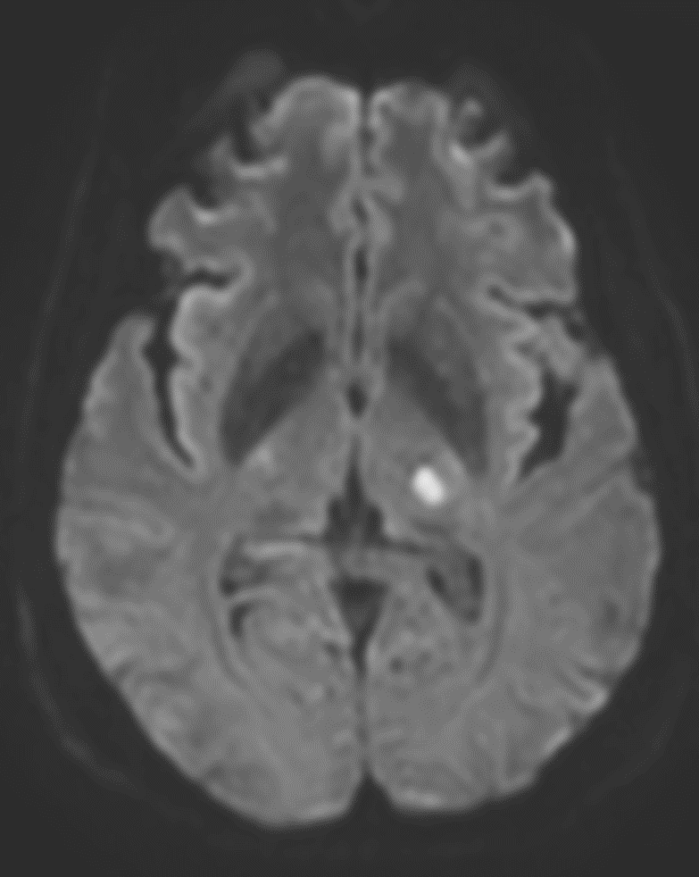
OCEANIC-STROKE: Study design
Index event was NCIS and no contraindications for MRI
Baseline MRI within 5 days of symptoms, either before randomization (as clinically initiated MRI) or after randomization (study MRI)
CEOT period safety
follow-up 2 weeks after
stopping study drug
Index
event
Screening
≤72 hours
Intervention period
~3–31 months
Informed consent
Asundexian 50 mg OD
N=6162
Adults aged
≥18 years
with acute NCIS
or high-risk TIA
on antiplatelet
therapy
Stratified by baseline intention to use DAPT
(ASA + P2Y12 inhibitor) vs no DAPT
1:1
N=12,337
Placebo OD
N=6165
Baseline MRI
≤5 days
ASA, acetylsalicylic acid; CEOT, common end of treatment; DAPT, dual antiplatelet therapy; MRI, magnetic resonance imaging; NCIS, non-cardioembolic ischemic stroke; OD, once daily; P2Y12, purinergic receptor Y12;
R, randomization; SAPT, single antiplatelet therapy; TIA, transient ischemic attack.
Sharma M, et al. Eur Stroke J. 2026;11(1):aakaf017.

Slide 5
Background and objective of MRI sub-study
Infarct pattern on MRI is associated with risk of stroke recurrence and bleeding
  Multiple DWI+ infarcts or cortical → higher rate of recurrence¹
  Small subcortical infarct → marker of intracranial bleeding risk²
Pre-specified objectives:
Evaluate the distribution of MRI infarct patterns in OCEANIC-STROKE, including proportion of single small subcortical infarct
Evaluate ischemic stroke recurrence and ISTH major bleeding according to baseline MRI infarct pattern
Explore whether the treatment effect of asundexian differed across infarct patterns
DWI, diffusion-weighted imaging; MRI, magnetic resonance imaging.
1. Wen HM, et al. Neurology. 2004;63(7):1317–1319. 2. Tanaka K, et al. Ann Neurol. 2024;95(4):774–787.

Slide 6
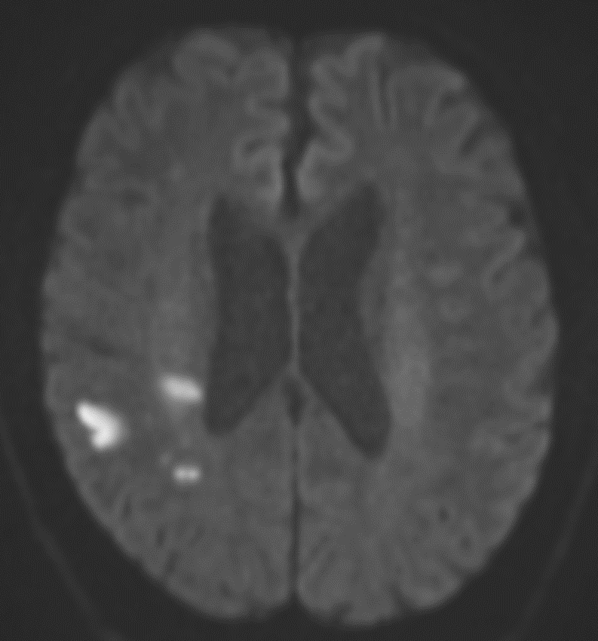
Methods: MRI substudy
Standardized MRI protocol: FLAIR, DWI, ADC, and SWI / GRE obtained within 5 days of index event. All sites provided phantom scans for qualification
MRI scans centrally adjudicated for presence of DWI+ lesions, location, and size, and
categorized as:
  Single small (<15 mm) subcortical infarct
  Multiple infarcts
  One or more large (>15 mm) infarcts
  One or more cortical infarcts
Potential
embolic
topography
Single, small subcortical
Multiple, large, or cortical†
†Patient can be in multiple categories.
ADC, apparent diffusion coefficient; DWI, diffusion-weighted imaging; DWI+, diffusion-weighted imaging–positive; FLAIR, fluid-attenuated inversion recovery; GRE, gradient-echo; MRI, magnetic resonance imaging;
SWI, susceptibility-weighted imaging.

Slide 7
Methods: MRI substudy
We described the proportions of each MRI infarct pattern
We calculated rates of ischemic stroke recurrence by baseline MRI infarct pattern
We used Cox proportional hazards models to calculate csHR stratified by baseline DAPT use for asundexian versus placebo on:
  recurrent ischemic stroke
  ISTH major bleeding
By baseline infarct pattern
csHR, cause-specific hazard ratio; DAPT, dual antiplatelet therapy; MRI, magnetic resonance imaging.

Slide 8
MRI sub-study participant flow
27 countries and 172 sites
Patients consented to the MRI sub-study
Overall 1310 | Asundexian 686 | Placebo 624
Excluded: index TIA
37 (2.8%) | 20 (2.9%) | 17 (2.7%)
Index ischemic stroke event
Overall 1273 (97.2%) | Asundexian 666 (97.1%) | Placebo 607 (97.3%)
Baseline MRI scan completed
Overall 1227 (96.4%) | Asundexian 646 (97.0%) | Placebo 581 (95.7%)
Interpretable baseline MRI scan
Overall 1126 (88.5%) | Asundexian 590 (88.6%) | Placebo 536 (88.3%)
Patients with baseline MRI included in analysis
Overall 1126 | Asundexian 590 | Placebo 536
DWI+ infarcts: 1076 (95.6%): Asundexian, 95.4%; placebo, 95.7%
DWI+, diffusion-weighted imaging positive; MRI, magnetic resonance imaging; TIA, transient ischemic attack.

Slide 9
Baseline characteristics of MRI substudy participants by treatment arms
Characteristic | Asundexian 50 mg N=590 | Placebo N=536
Age, mean (SD), years | 67.7 (10.2) | 67.0 (10.5)
Female sex, n (%) | 194 (32.9) | 160 (29.9)
Medical history, n (%)
Current or former tobacco use | 276 (46.8) | 293 (54.7)
Hypertension | 460 (78.0) | 419 (78.2)
Diabetes | 202 (34.2) | 185 (34.5)
Previous stroke or TIA | 112 (19.0) | 113 (21.1)
Coronary artery disease | 92 (15.6) | 77 (14.4)
TOAST classification, n (%)
Large-artery atherosclerosis | 248 (42.0) | 229 (42.7)
Small-vessel occlusion (lacune) | 122 (20.7) | 117 (21.8)
Other determined etiology | 13 (2.2) | 16 (3.0)
Undetermined etiology | 197 (33.4) | 160 (29.9)
Cardioembolism | 10 (1.7) | 14 (2.6)
NIHSS at randomization, median (IQR) | 2.0 (1.0–4.0) | 2.0 (1.0–4.0)
Intravenous thrombolysis only, n (%) | 123 (20.8) | 115 (21.5)
Endovascular therapy ± IV thrombolysis, n (%) | 32 (5.4) | 43 (8.0)
Planned DAPT, n (%) | 352 (59.7) | 311 (58.0)
Time from index event to baseline MRI, mean (SD), hours | 58.2 (39.9) | 56.5 (34.3)
DAPT, dual antiplatelet therapy; IQR, interquartile range; IV, intravenous; MRI, magnetic resonance imaging; NIHSS, National Institutes of Health Stroke Scale; SD, standard deviation; TIA, transient ischemic attack;
TOAST, Trial of Org 10172 in Acute Stroke Treatment.
Notes:
Baseline characteristics of participants in main OCEANIC trial and MRI substudy were similar
Baseline characteristics were similar between study arms

Slide 10
Baseline hemorrhagic transformation and white matter hyperintensity severity by treatment (DWI+ population)
Hemorrhagic transformation of any DWI+ infarcts (highest class observed), n (%) | Asundexian 50 mg N=563 | Placebo N=513
None | 404 (71.8) | 375 (73.1)
Yes | 159 (28.2) | 138 (26.9)
HI1 | 94 (16.7) | 77 (15.0)
HI2 | 62 (11.0) | 60 (11.7)
PH1 | 3 (0.5) | 1 (0.2)
PH2 | 0 (0.0) | 0 (0.0)
Fazekas score: Peri-ventricular
0: Absent | 67 (11.9) | 78 (15.2)
1: Caps or pencil-thin lining | 261 (46.4) | 238 (46.4)
2: Smooth halo | 174 (30.9) | 145 (28.3)
3: Irregular periventricular signal extending into deep white matter | 61 (10.8) | 52 (10.1)
Deep white matter Fazekas score
0: Absent | 39 (6.9) | 61 (11.9)
1: Punctuate foci | 269 (47.8) | 244 (47.6)
2: Beginning confluence | 189 (33.6) | 157 (30.6)
3: Large confluent areas | 66 (11.7) | 51 (9.9)
DWI+, diffusion-weighted imaging–positive; HI, hemorrhagic infarction; PH, parenchymal hematoma.

Slide 11
Baseline microbleed severity by treatment
Microbleeds | Asundexian 50 mg N=590 | Placebo N=536
No | 361 (61.2) | 316 (59.0)
Yes | 229 (38.8) | 220 (41.0)
Microbleed count
Mean (SD) | 4.5 (10.1) | 5.5 (11.2)
Median (IQR) | 2 (1–4) | 2 (1–4)
Median (min, max) | 2 (1–127) | 2 (1–108)
Microbleed severity
1–2 CMBs | 143 (62.4) | 135 (61.4)
3–10 CMBs | 66 (28.8) | 63 (28.6)
>10 CMBs | 20 (8.7) | 22 (10.0)
Chronic intraparenchymal macrobleeds (>10 mm) present (excluding hemorrhagic transformation of infarcts) | 15 (2.5) | 11 (2.1)
CMB, cerebral microbleed; IQR, interquartile range.
Notes:
There was a high prevalence of CMBs

Slide 12
Prevalence of baseline MRI lesion types was comparable between treatment arms
(DWI+ population)†
Asundexian 50 mg
Placebo
Patients with pattern (%)
Single small
subcortical
Multiple, large or cortical
Multiple infarcts
Large infarcts (>15 mm)
Cortical infarcts
†Lesion categories overlap and need not sum to 100%.
DWI+, diffusion-weighted imaging–positive; MRI, magnetic resonance imaging.
Baseline MRI patterns

Slide 13
Efficacy endpoints: ischemic stroke and all stroke
Variable, n (%) | Overall with baseline scan | Asundexian 50 mg | Placebo | csHR (95% CI)
Ischemic stroke
All MRI sub-study population* | 111/1126 (9.9) | 47/590 (8.0) | 64/536 (11.9) | 0.66 (0.45–0.96)
DWI+ population | 108/1076 (10.0) | 46/563 (8.2) | 62/513 (12.1) | 0.67 (0.46–0.98)
All stroke† (ischemic and hemorrhagic stroke)
All MRI sub-study | 115/1126 (10.2) | 49/590 (8.3) | 66/536 (12.3) | 0.66 (0.46–0.96)
DWI+ population | 112/1076 (10.4) | 48/563 (8.5) | 64/513 (12.5) | 0.67 (0.46–0.98)
*Median follow-up 1.7 years, IQR 1.04-2.07
†There were two hemorrhagic strokes in each arm
CI, confidence interval; csHR, cause-specific hazard ratio; DWI+, diffusion-weighted imaging–positive; MRI, magnetic resonance imaging.

Slide 14
Occurrence of ischemic stroke by treatment, stratified by baseline infarct pattern
(DWI+ population)
Asundexian 50 mg
Placebo
Ischemic stroke (%)
Overall
Single small subcortical
Multiple, large or cortical
Baseline MRI patterns

Slide 15
Occurrence of ischemic stroke by treatment, stratified by baseline infarct pattern
(DWI+ population)
Asundexian 50 mg
Placebo
Ischemic stroke (%)
Multiple infarcts
Only a single infarct
Large infarcts
(>15 mm)
Only small infarcts
Cortical
infarcts
Only subcortical infarcts
DWI+, diffusion-weighted imaging–positive; MRI, magnetic resonance imaging.

Slide 16
Efficacy: Ischemic stroke
There was no heterogeneity of treatment effect of asundexian on ischemic stroke according to baseline infarct pattern
DWI+ population
CI, confidence interval; csHR, cause-specific hazard ratio; DWI+, diffusion-weighted imaging–positive; HR, hazard ratio; MRI, magnetic resonance imaging.
Notes:
Oceanic DWI+

Slide 17
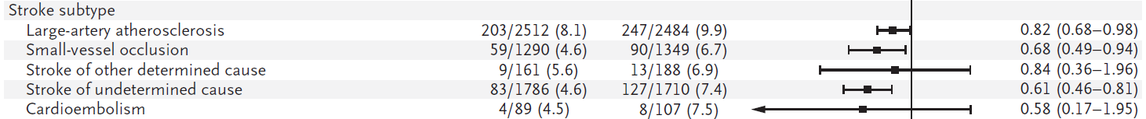
The efficacy across MRI infarct patterns is consistent with the results of the TOAST clinical subtypes in the main OCEANIC trial
MRI, magnetic resonance imaging; TOAST, Trial of Org 10172 in Acute Stroke Treatment.
Sharma M, et al. N Engl J Med. 2026;394(15):1467–1479.

Slide 18
Safety: ISTH major bleeding
There was no heterogenicity of treatment effect of asundexian on ISTH major bleeding according to baseline infarct pattern
DWI+ population
†
Multiple infarcts
CI, confidence interval; csHR, cause-specific hazard ratio; DWI+, diffusion-weighted imaging–positive; HR, hazard ratio; ISTH, International Society on Thrombosis and Haemostasis. MRI, magnetic resonance imaging.
Three symptomatic intracranial hemorrhages in each arm

Slide 19
Conclusion
Baseline infarct patterns in the MRI sub-study included all expected patterns, including single small subcortical strokes
The treatment effect of asundexian was directionally consistent across baseline MRI infarct patterns, with no evidence of treatment-effect heterogeneity
  The MRI results are consistent with, and reinforce, results of the TOAST subgroup analysis demonstrating effect of asundexian across clinical categories
There was no increase in ISTH major bleeding across MRI infarct patterns and only two hemorrhagic stroke occurrences in each arm, despite high prevalence of hemorrhagic transformation (~30%) and microbleeds (~40%)
ISTH, International Society on Thrombosis and Haemostasis; MRI, magnetic resonance imaging; TOAST, Trial of Org 10172 in Acute Stroke Treatment.

Slide 20

Acknowledgments
The authors thank the Steering Committee and independent Data Monitoring Committee members, the study operations teams, the OCEANIC investigators including the MRI substudy investigators, the study site coordinators, the imaging core lab, and especially the patients and their families, who made this study possible.
This study was funded Bayer AG. Asundexian is not yet approved for use.
Editorial support was provided by Prime Group of Companies (Knutsford, UK), funded by Bayer AG
Scan to view the oral presentation slides:

